Slide 1
Loan Providers’ Risk Analysis Case Study
Souvik Sarkar

Slide 2
Business risks and Decision taking
Loan providers face two types of risks in order to rejecting/approving the loan applications
If applicants likely to repay loan, then not providing the loan results in a loss of business
If applicant is not likely to repay loan, then providing the loan also results in a loss of business.
Loan providers may receive applications from 2 types of applicant
The Client with payment difficulties and he/she had late payment more than X days on at least one of the first Y instalments of the loan
All other cases where no defaults happened in near past.
Based on the applicants loan payment history Loan providers can take following decisions
Approved
Cancelled
Refused
Unused Offer

Slide 3
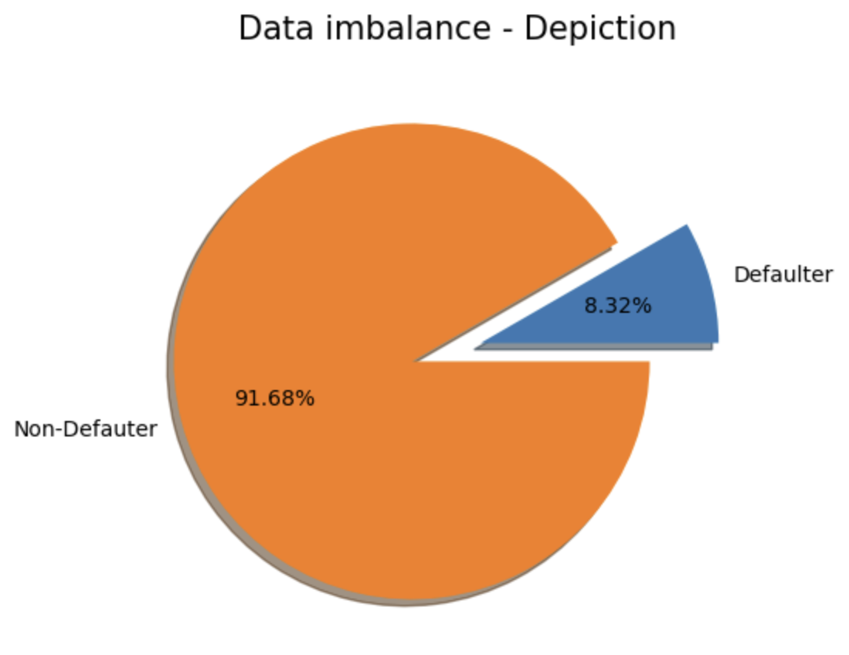
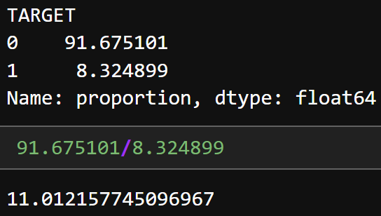
Data Imbalance
When data have been segregated into 2 types Defaulters(Target 1) and Non-Defaulters(Target 0), it reveals the data imbalance
We can see data imbalance ratio is almost 11:1

Slide 4
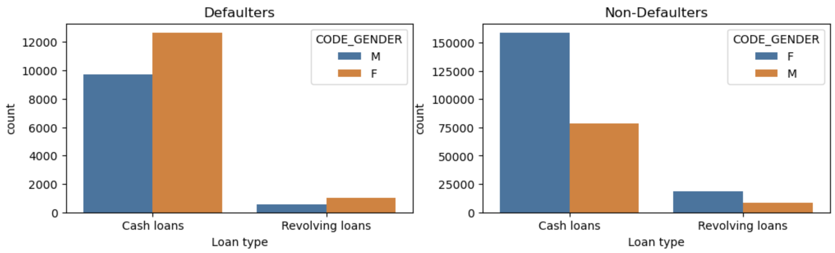
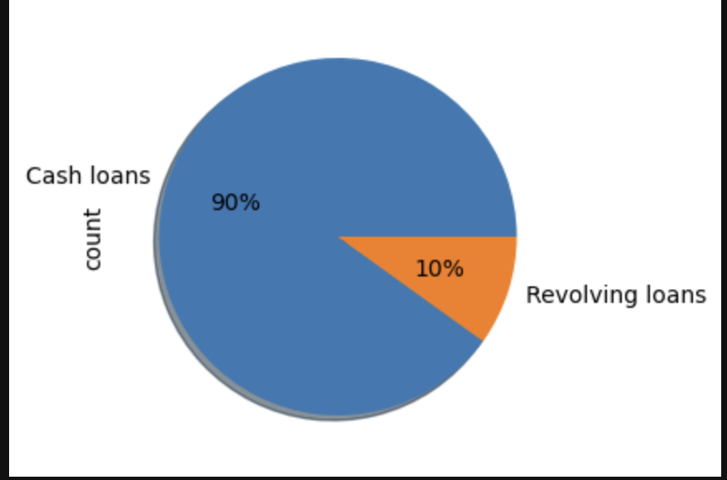
Univariate Analysis of Categorical columns
Two types of loans
Cash Loans
Revolving loans
Analysis :
Cash loan clients has more payment
Defaulters than revolving loans.
Loan providers should pitch or market
the revolving loans more.

Slide 5
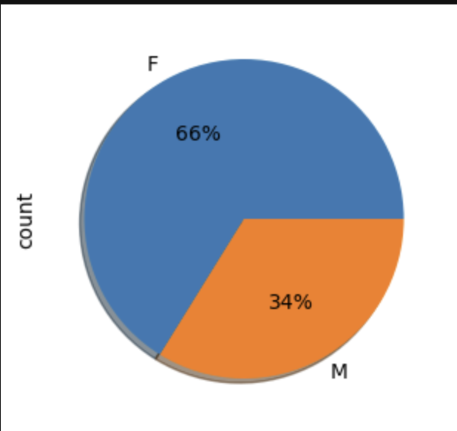
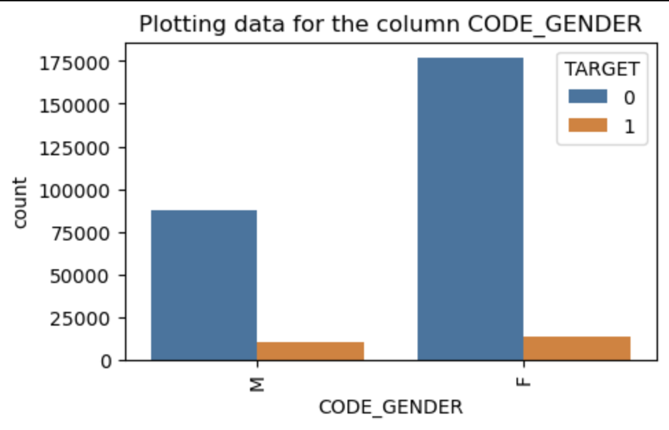
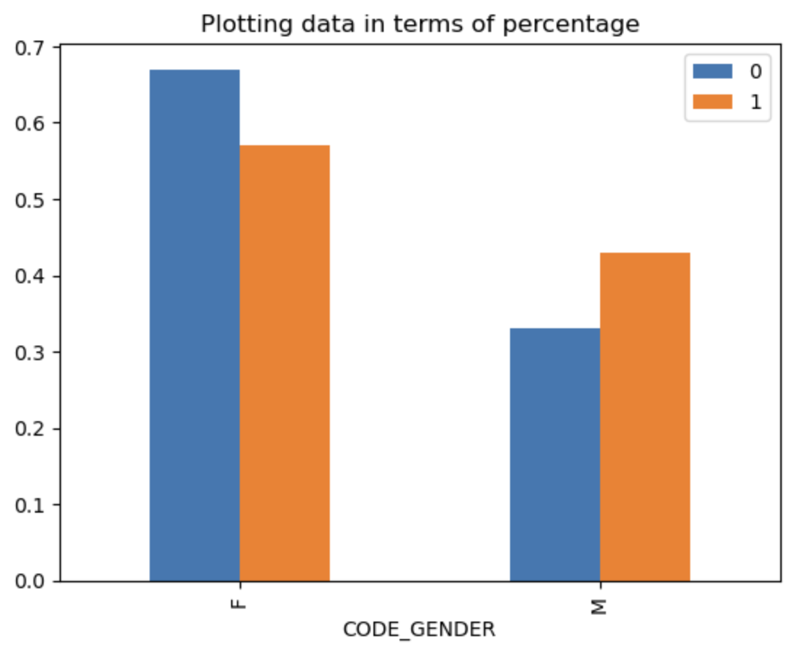
Clearly Females are tends to apply loan more
Even though the numbers of female applicants are much higher side Male applicants has the higher payment difficulty
Loan providers should keep on focusing on female clients

Slide 6
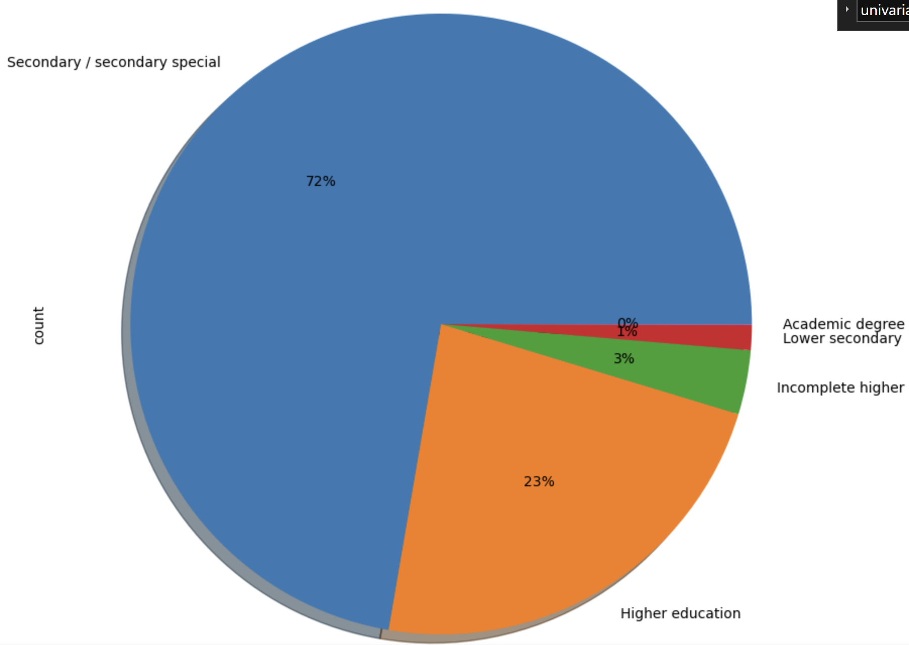
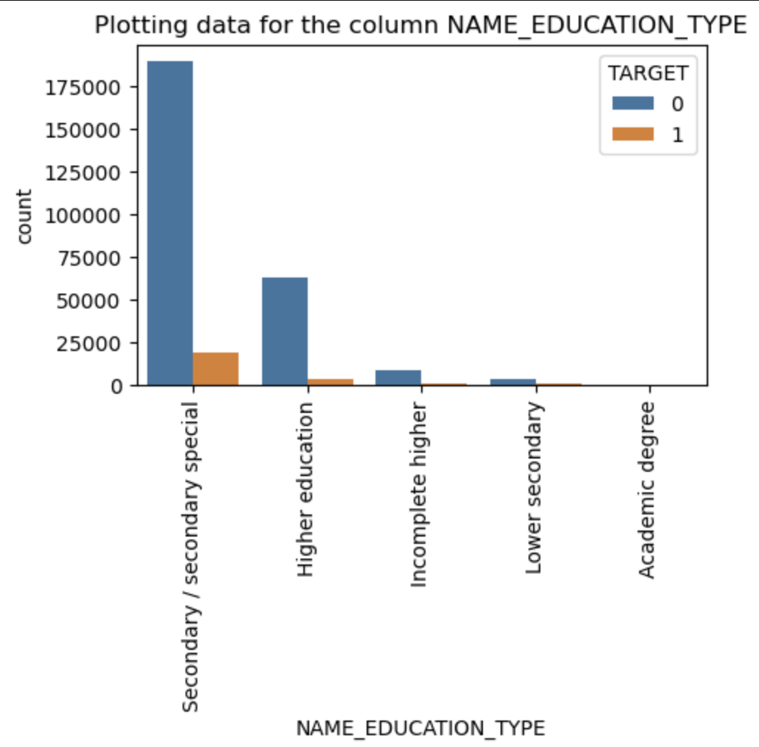
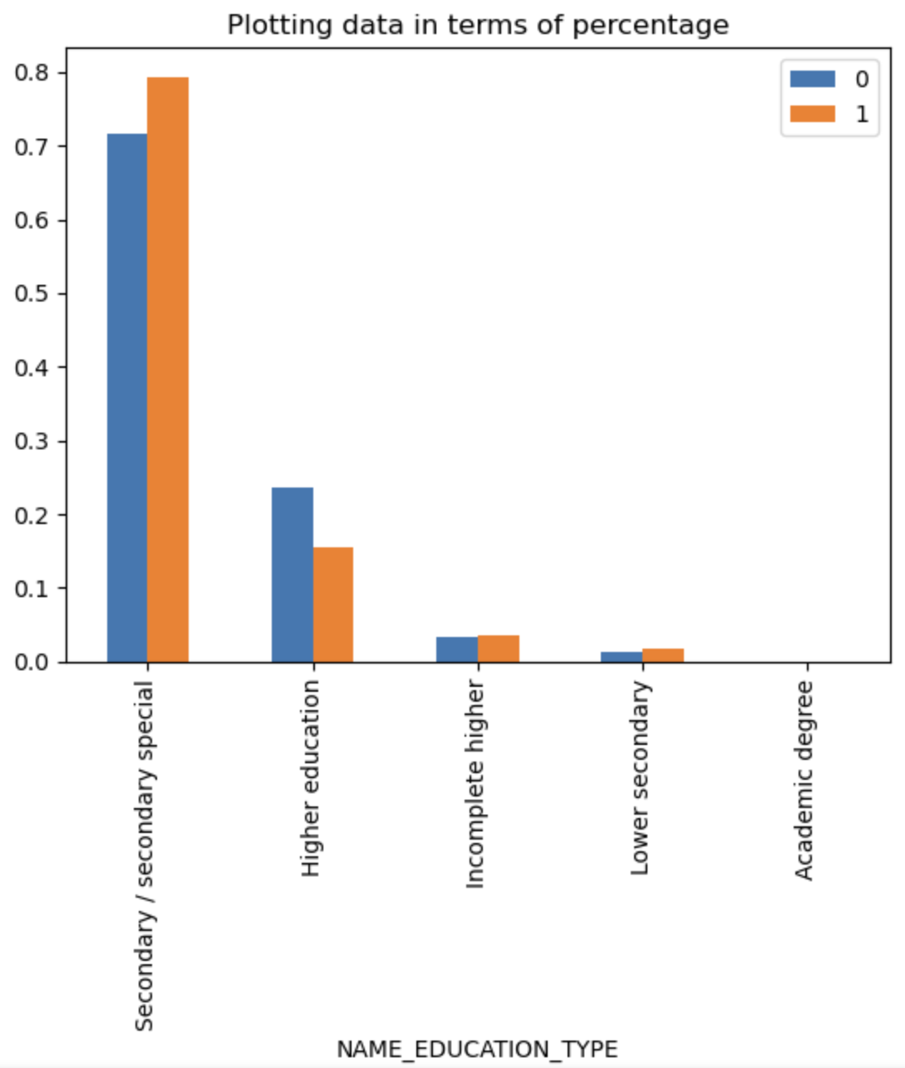
Maximum number of loans have been provided to the Secondary/Secondary special applicants.
Analysis : which depicts Secondary/Secondary special class has the most requirements of money
Higher education people have less difficulties in payment
Insight : Better education provides better job which pays well

Slide 7
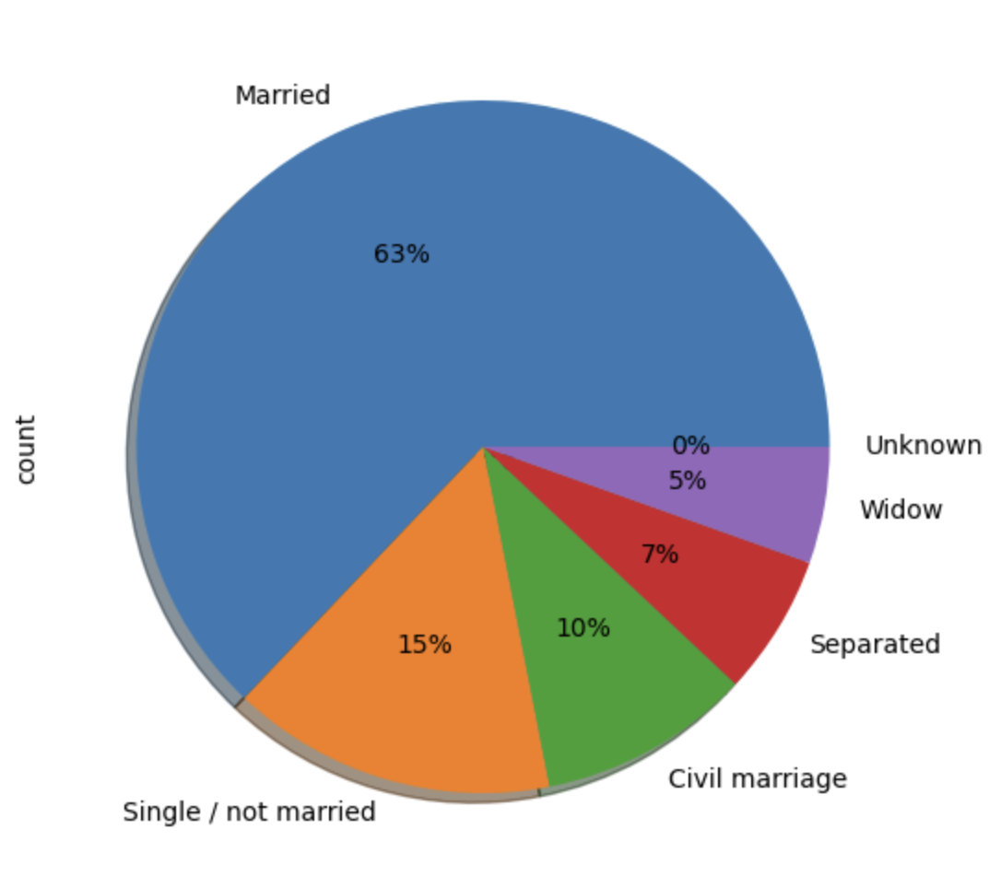
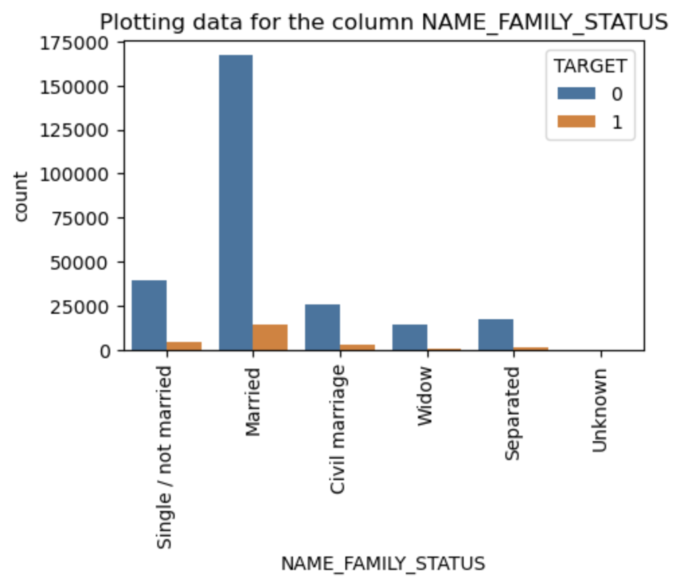
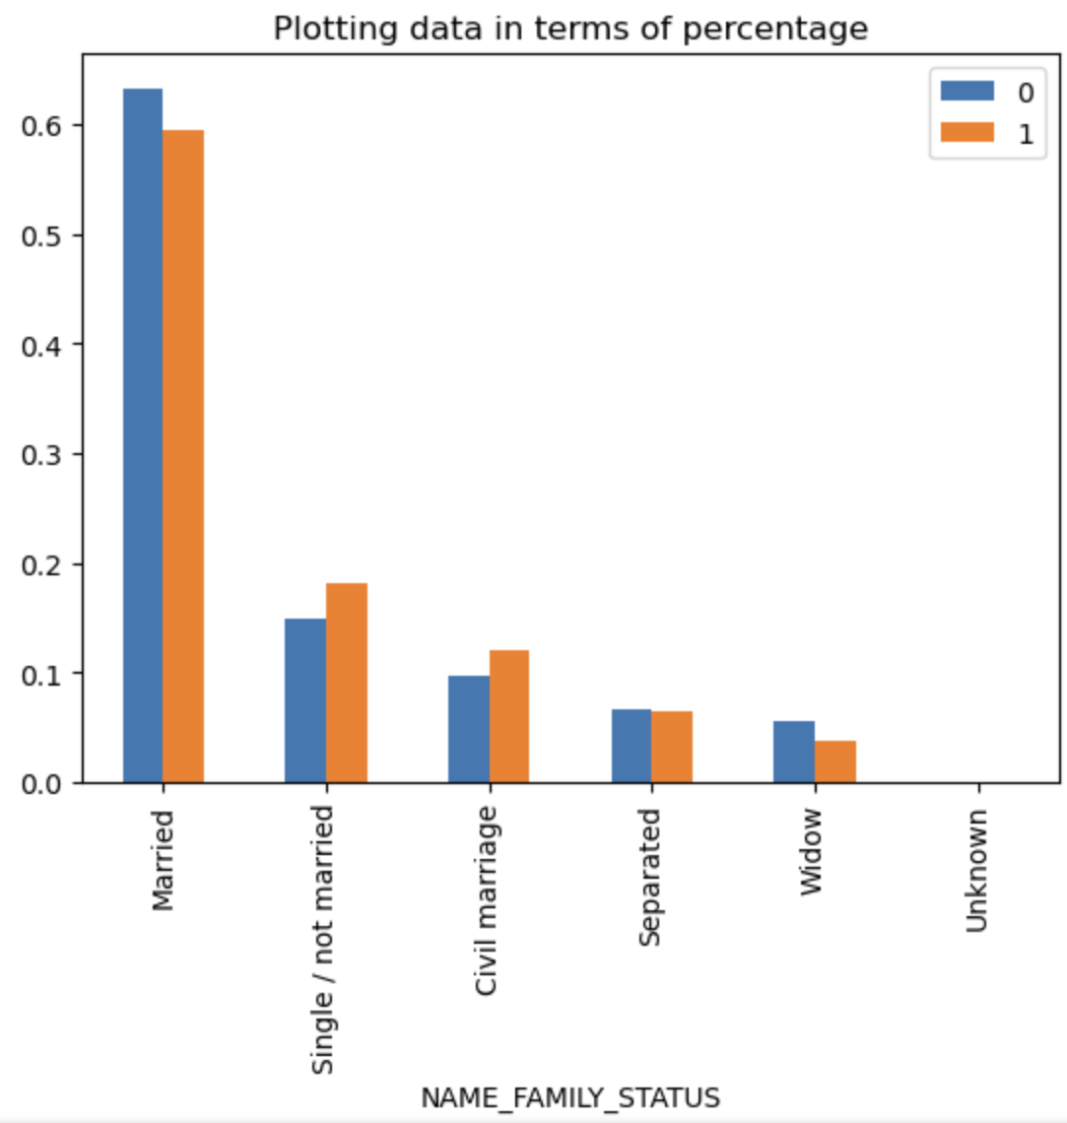
Married people are in urgent needs of money hence they have taken more than 60% of loans
Single/Not married and Civil marriage people surprisingly have more difficulties in paying off the loan
Probably married people are frugal and tends to manage money wisely

Slide 8
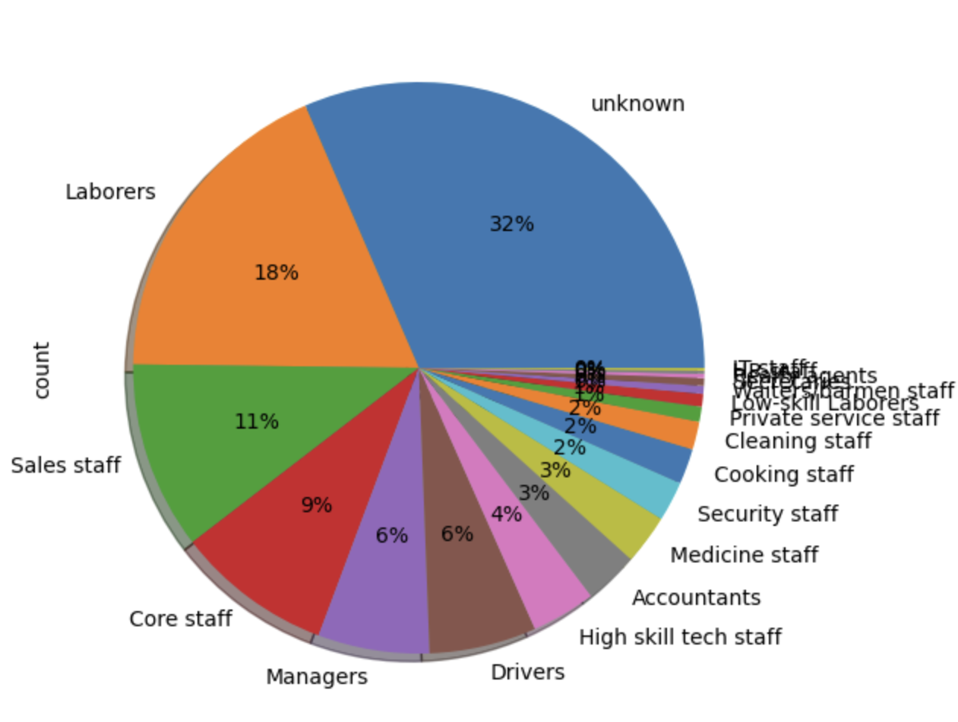
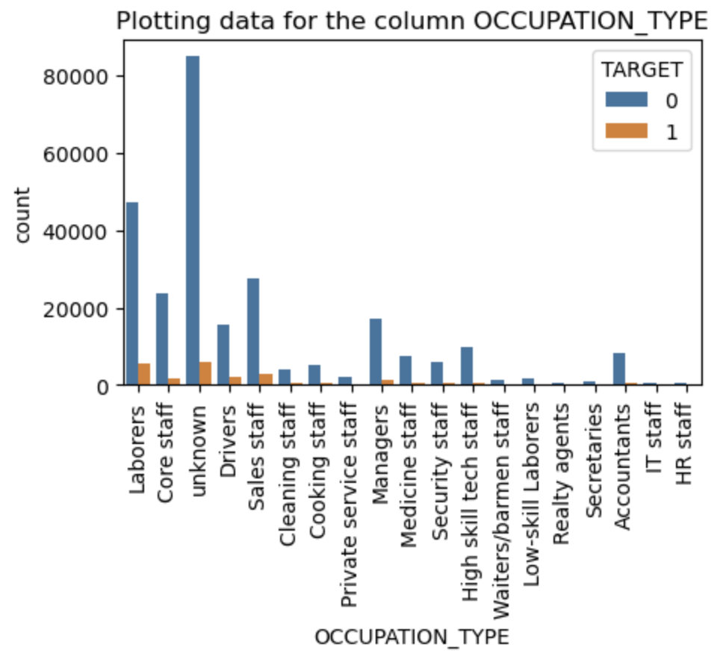
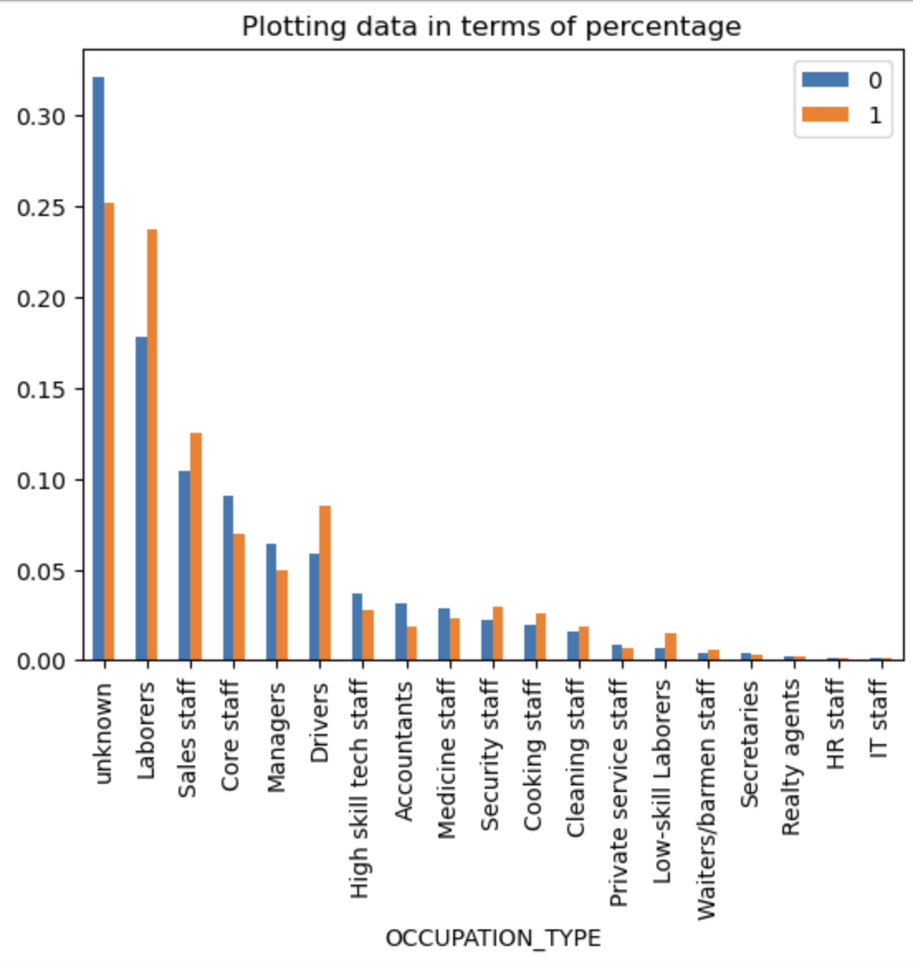
Unknown Occupation type has consume maximum numbers of loan
Defaulters rate in Laborers or other low paying jobs are on higher side
Loan provider should mandatorily capture the occupation type as unknow category is the best performing category in terms of loan providers’ revenue.

Slide 9
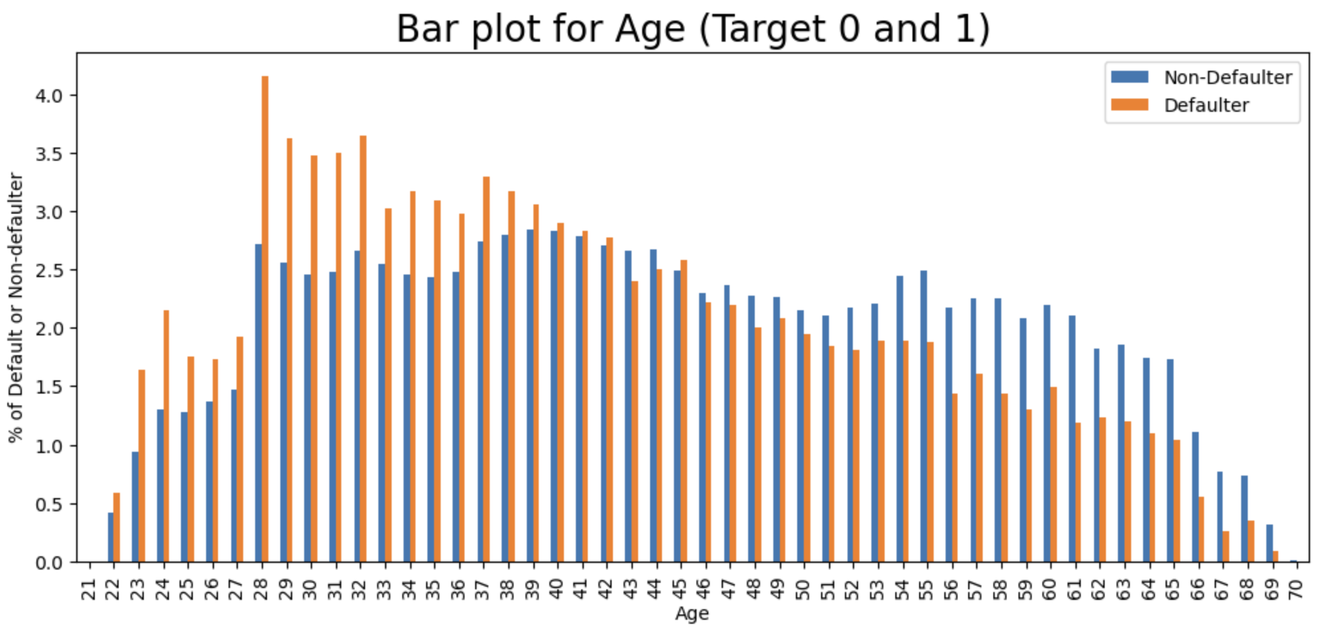
28-42 age group has the highest rate of defaulters due to less financial stability
Old people has the better financial stability
Loan providers should target age group more than 43

Slide 10
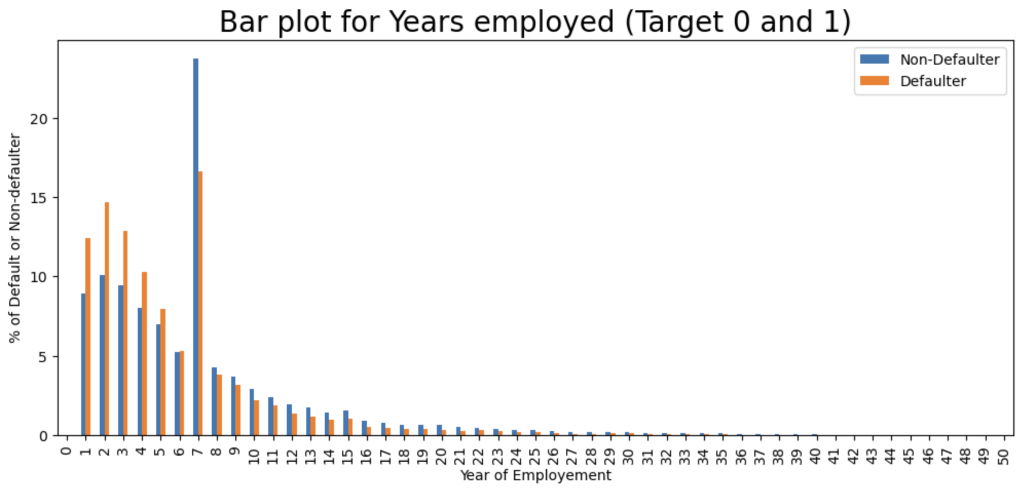
At initial stage people tends to have more financial need hence is why the people work ex less than of 7 has higher tendency to default
Loan providers should target people who has 7-10 years of work ex. Apparently people having 7 year of work ex are tend to have higher density in the dataset

Slide 11
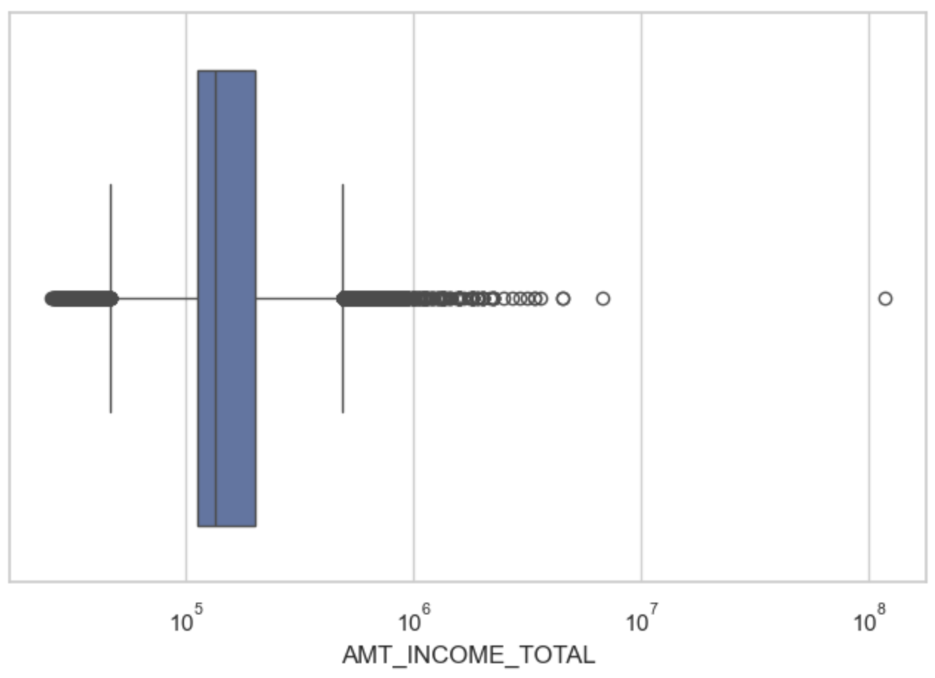
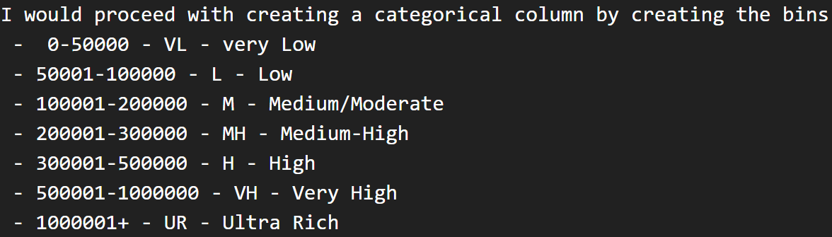
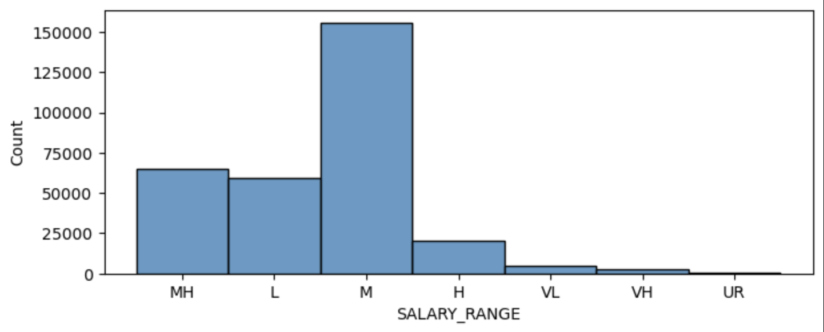
Univariate/Bivariate Analysis & Outliers for Numerical columns
AMT_INCOME_TOTAL column had outliers and to tackle this I have created a separate column ‘SALARY_RANGE’ and limit the salary without loosing any data

Slide 12
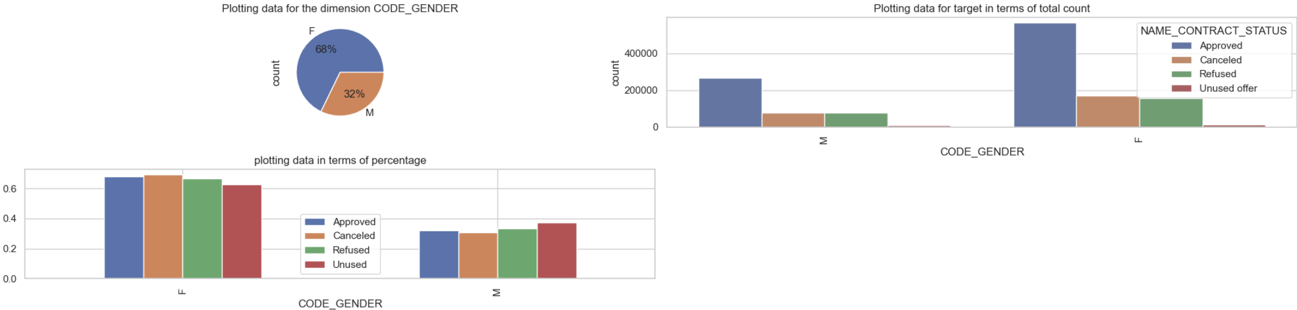
Merged data
Sample has the most numbers of Female applicants hence in all cases such as Approved, Cancelled, Refused and Unused, Female has the higher rate compared to male applicants

Slide 13
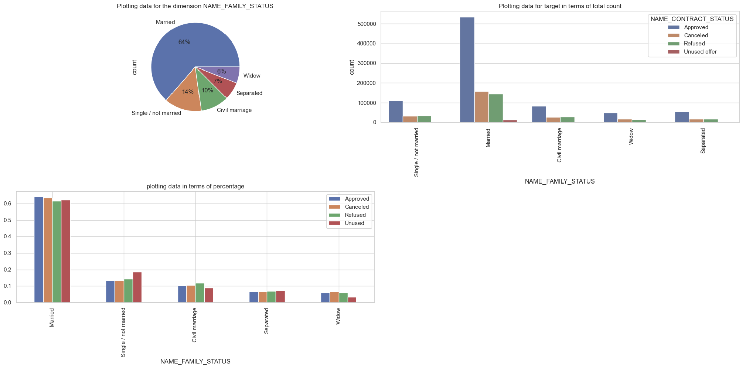
Married peoples has the dominance in all categories
Single/ not married people has the highest % in unused category
Civil and single/not married people have the highest %rate of refused loan compared to others

Slide 14
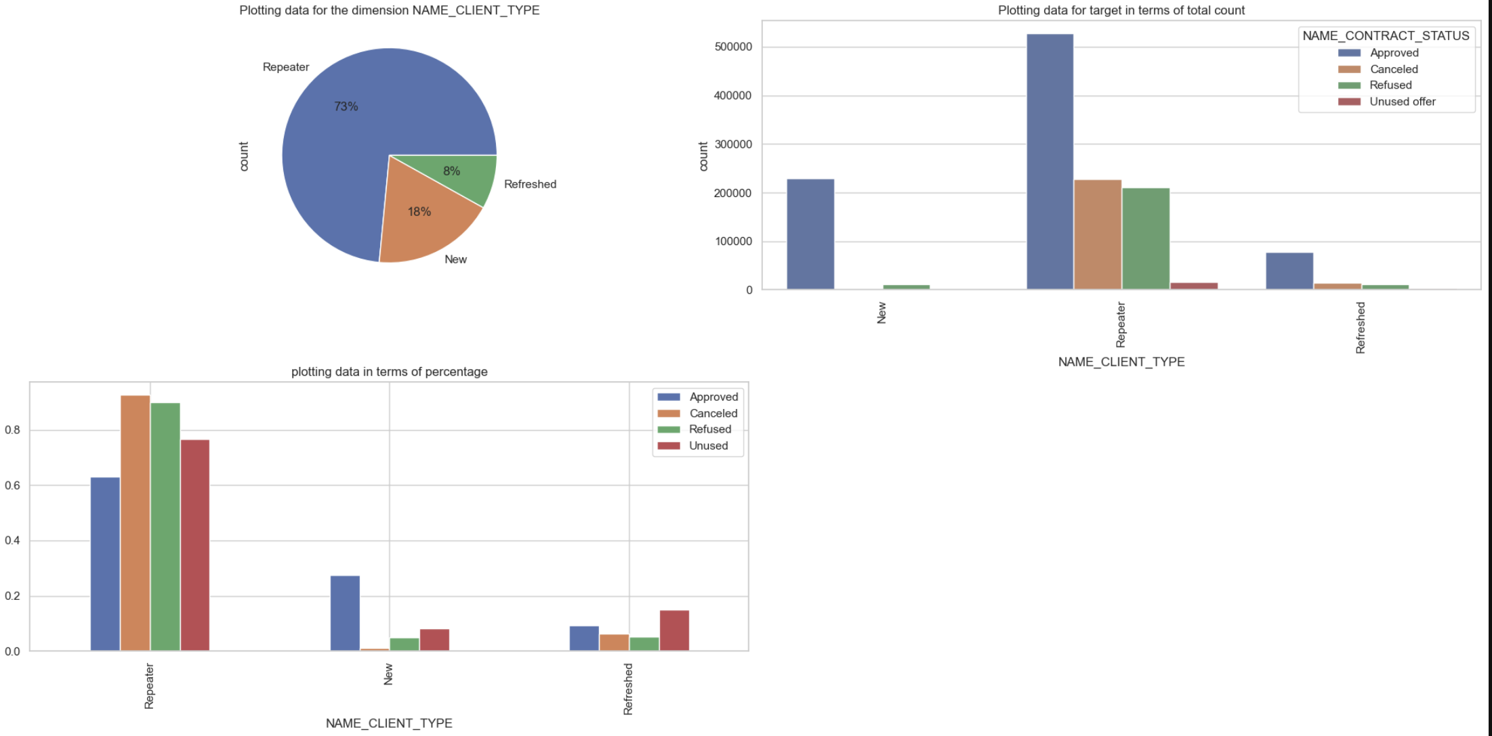
Loan Repeater has the dominance in the loan application
Repeater has the highest % of Refused and cancelled rate.
Refreshed has the highest rate of unused if we consider the numbers of applications for each category
New has the highest rate of approval if we consider the numbers of applications for each category

Slide 15
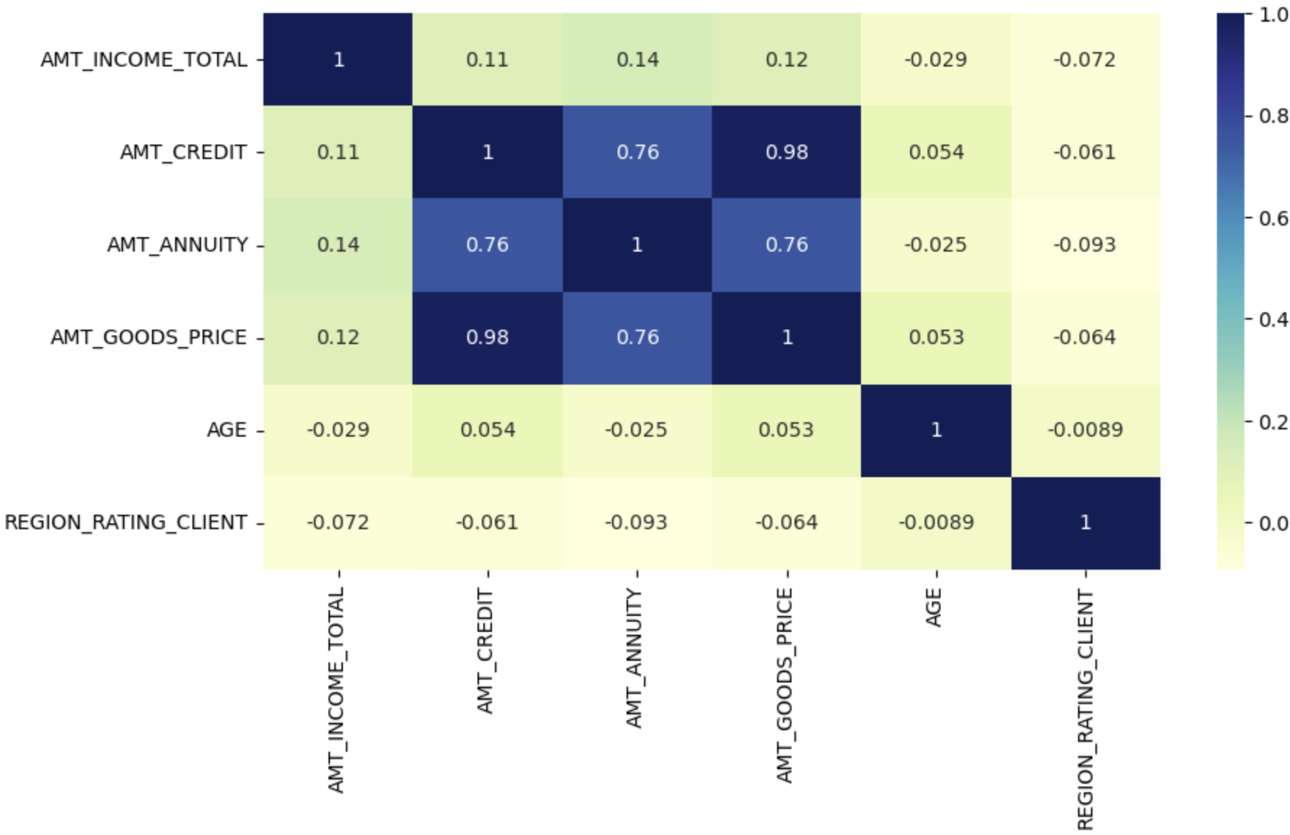
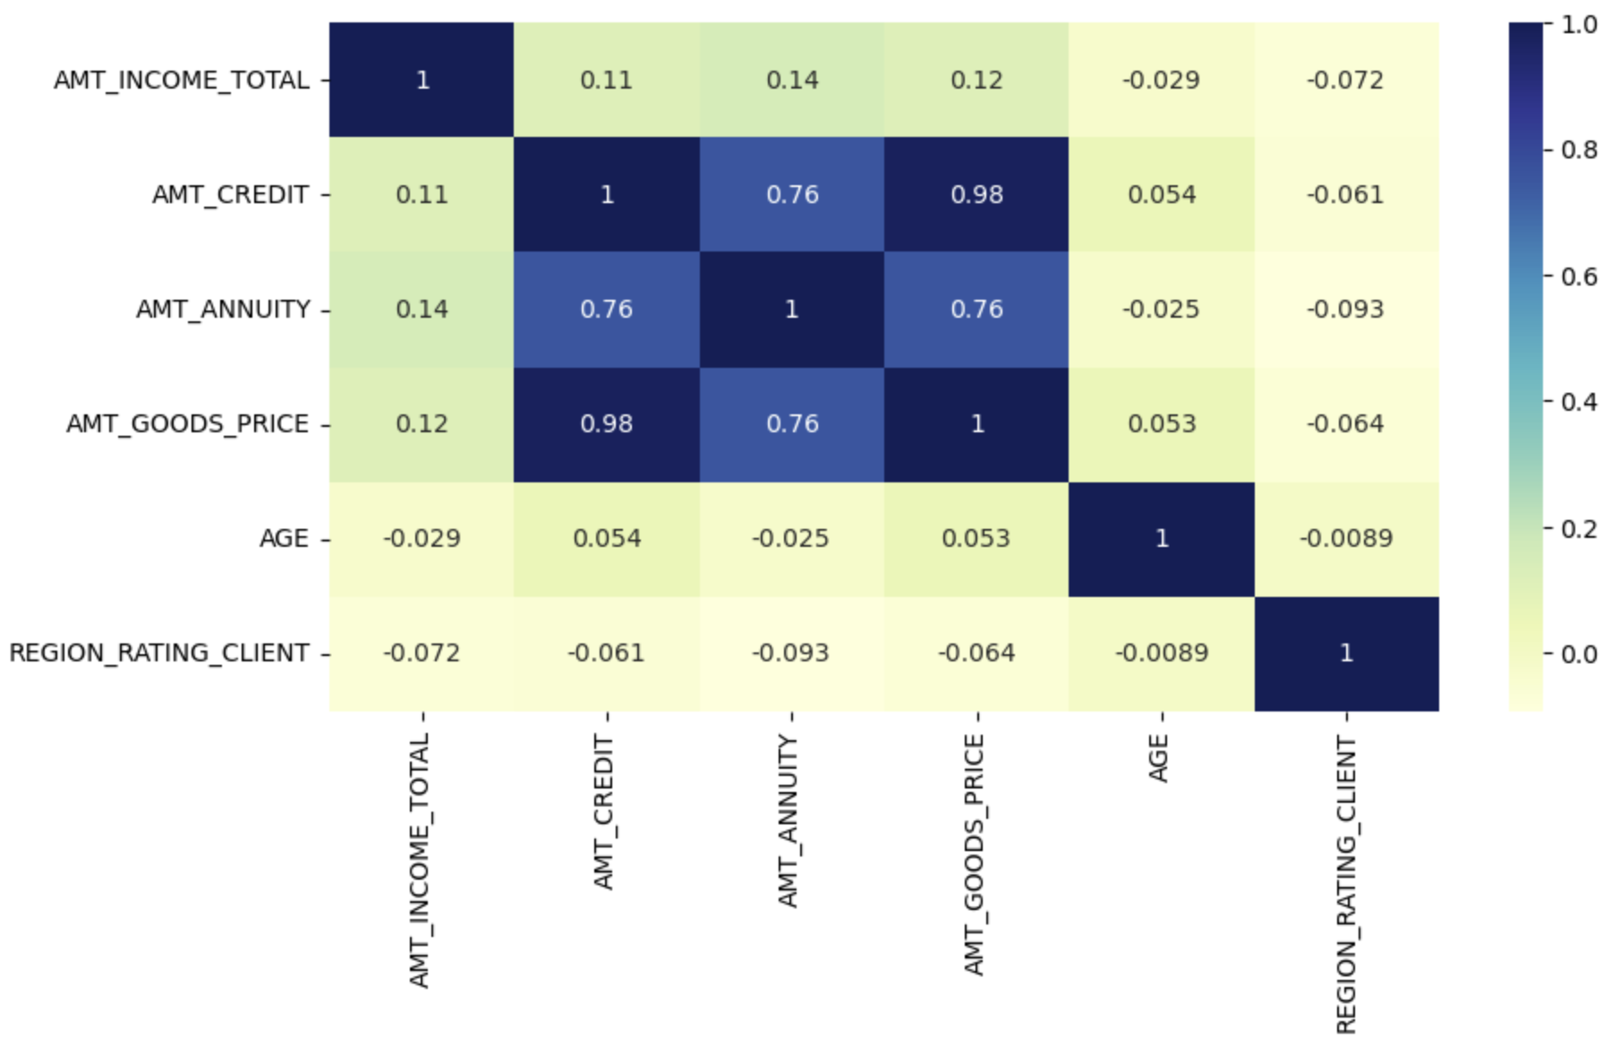
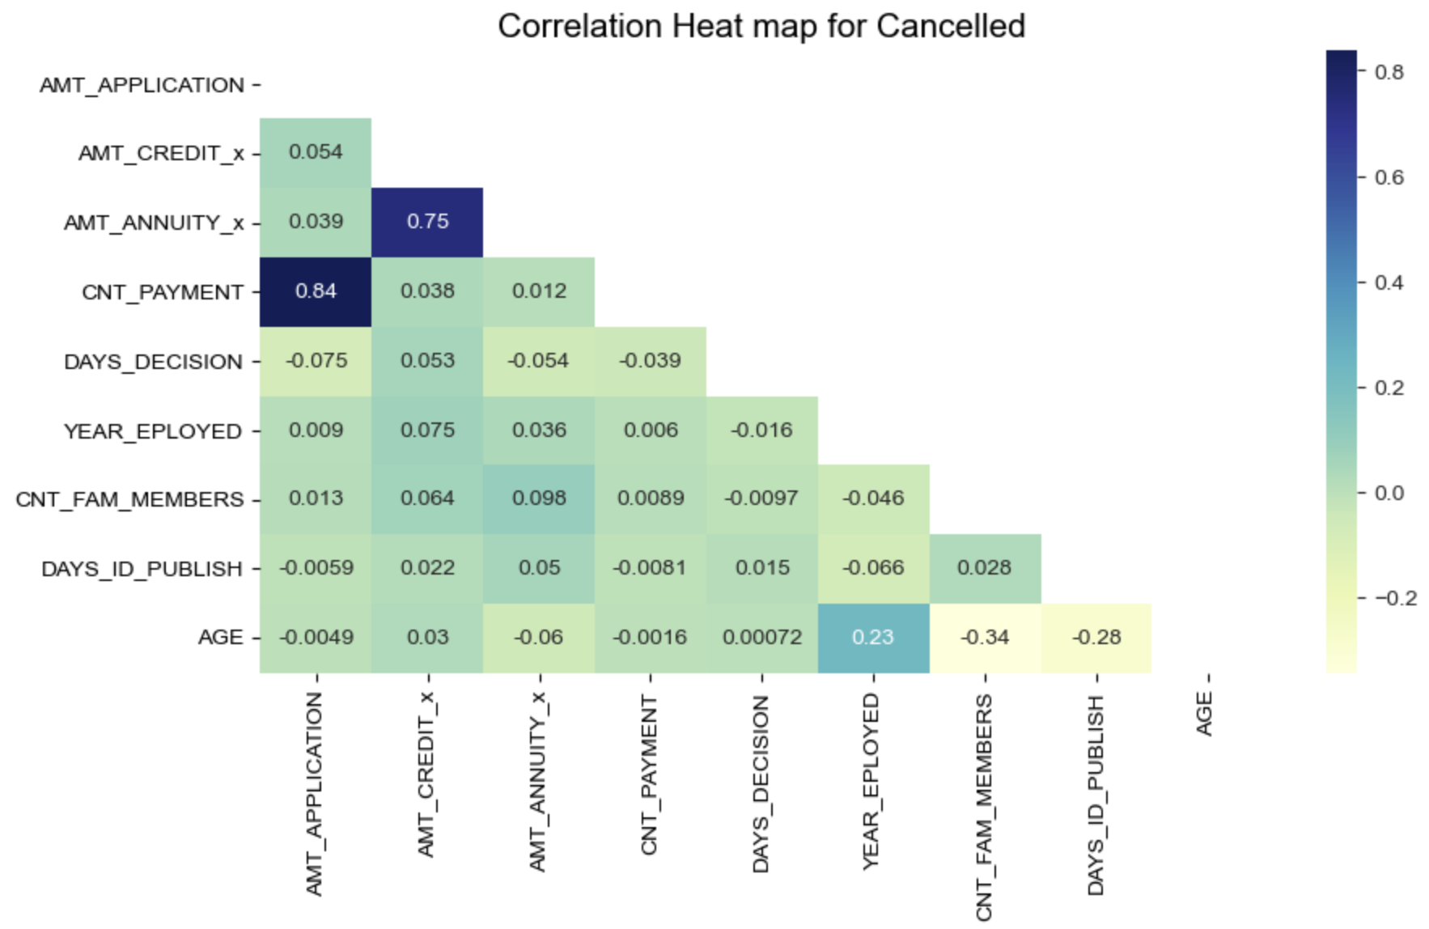
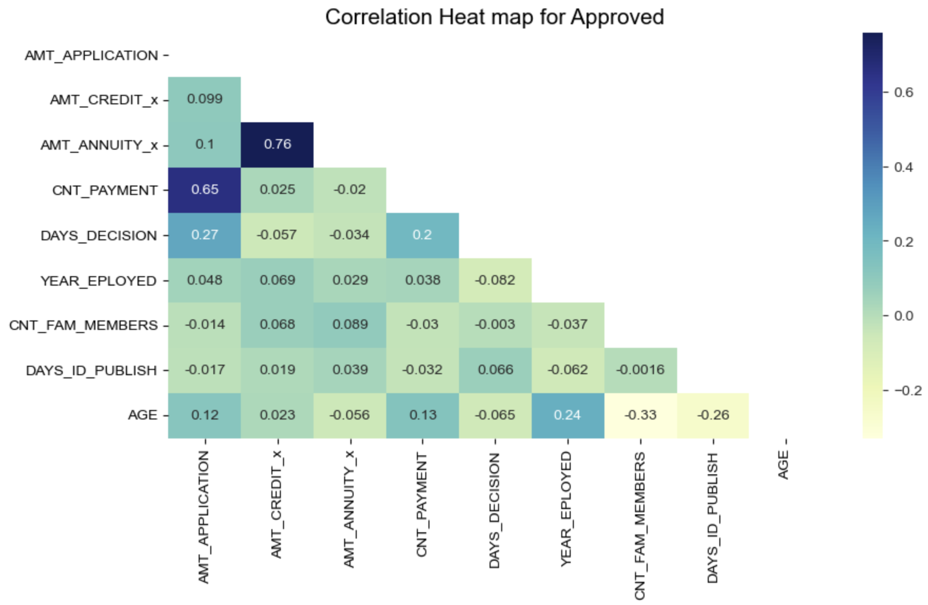
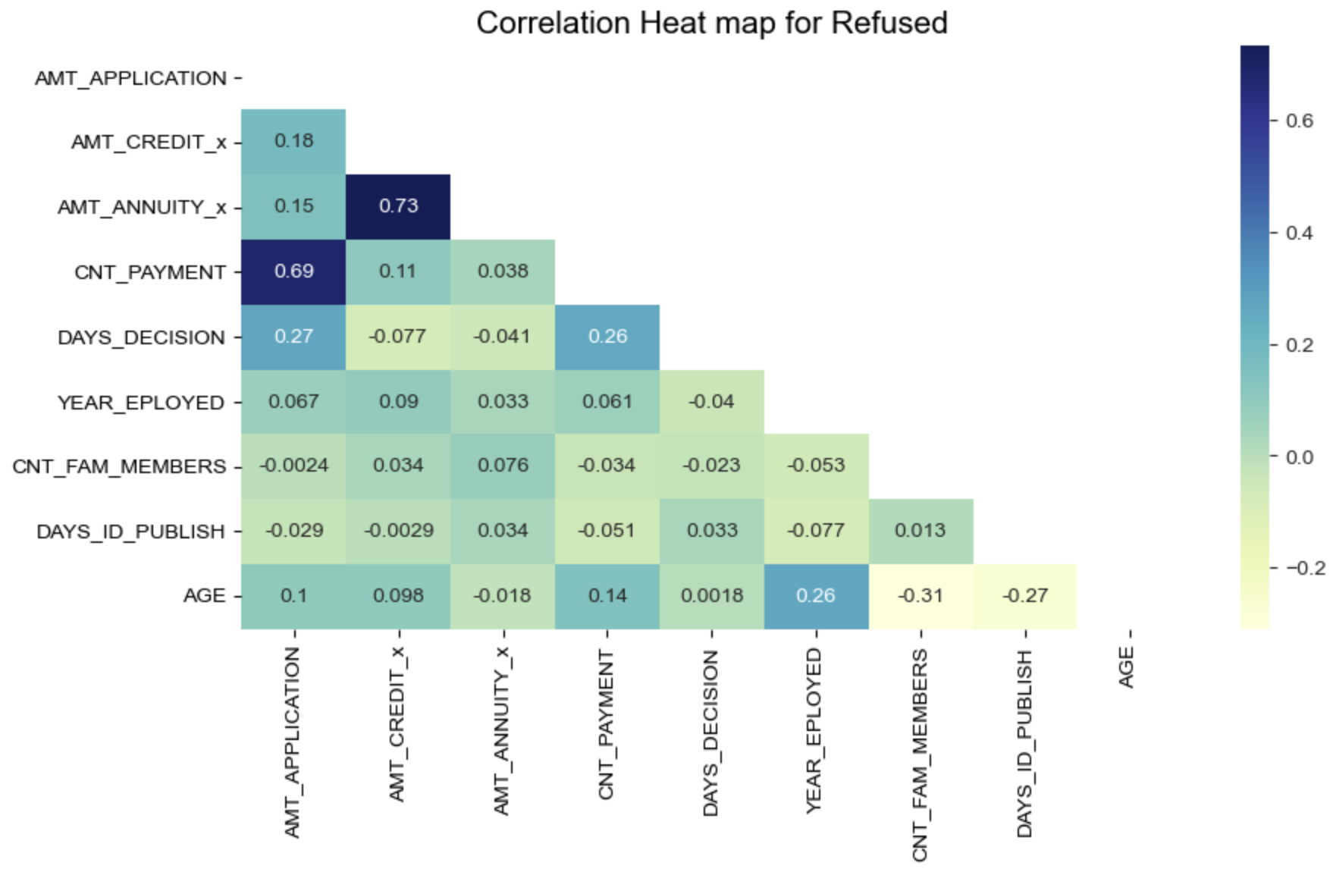
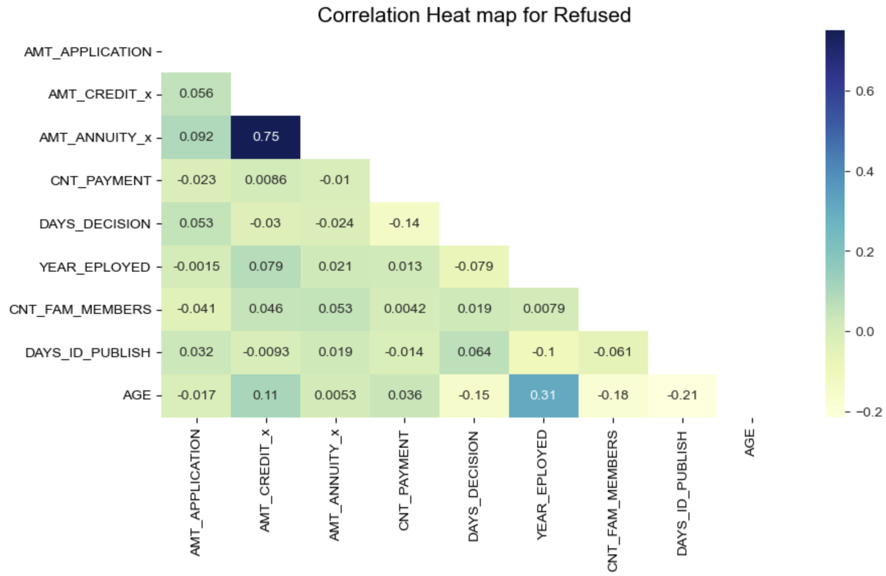
Correlation

Slide 16
Suggestions:
Loan providers should target more the education type 'Higher education' and try to avoid Secondary/secondary special, incomplete higher or lower secondary as they face payment difficulties.
Avoid 'Working' clients as they have high percentage of payment difficulties. Rather focus on Commercial associate, pensioner and State servant.
Should focus on applicants from housing type ‘House/apartment’ Yes as they are having less payment difficulties.
Loan Providers should keep on focusing on Female clients, as they have the low percentage of default rate compared to Male applicants.
Loan Providers should track the occupation type more seriously as 'Unknown' type has the highest % of successful loan payment history. If we can reveal the OCCUPATION_TYPE for those class Loan Providers can easily target the group.
Loan Providers should focus on the client from age group of 43 to 70 as they will be financial stable and shows less paying difficulties.

Slide 17
Thank You! linkedin.com ------ > Souvik Sarkar

